Slide 1
Improving Text Extraction for RAG
Abheek Gulati

Slide 2

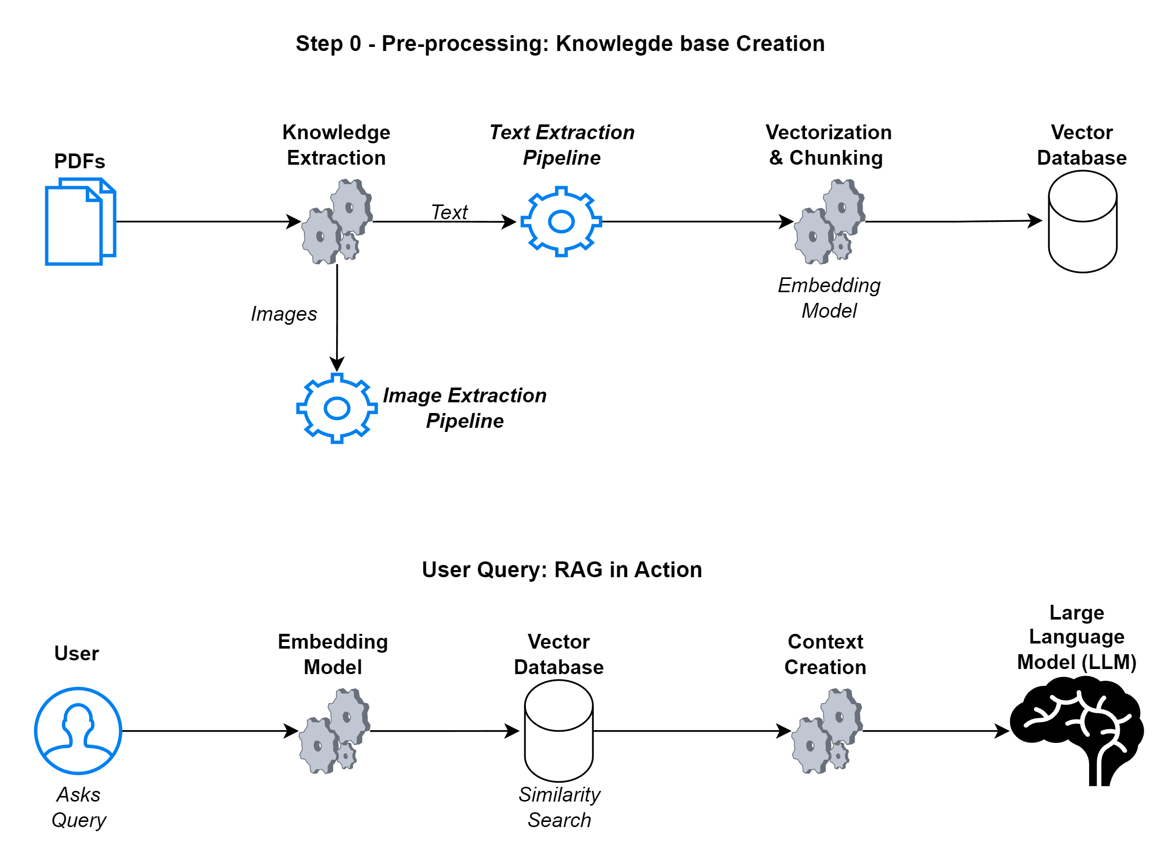
RAG Refresher

Slide 3
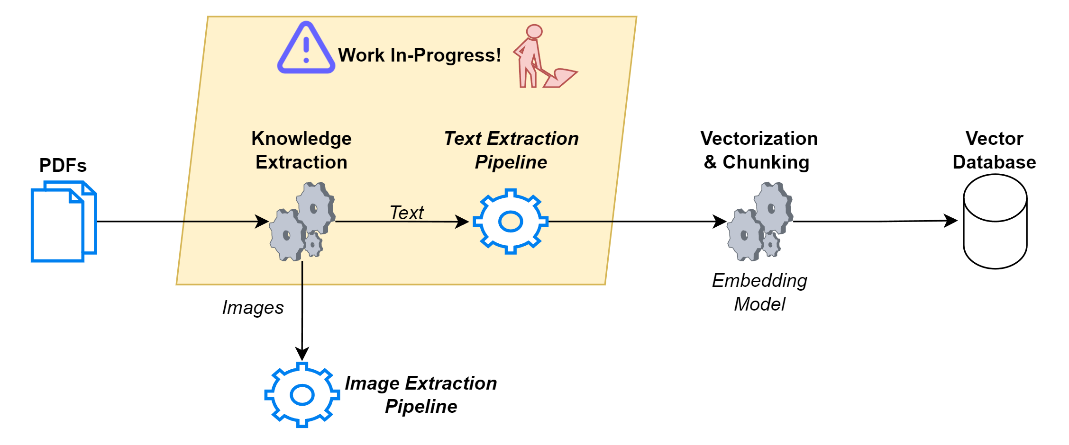
Refinement In-Progress

Slide 4
Defining “Refinement”
Objectives:
A RAG pipeline is large & complex with many working parts, identify areas for improvement
Get into depths of the base implementation
Explore alternatives with a hands-on approach: experiment and gather evaluation data
Build expertise if results are promising: Explore fringe areas on the cutting-edge of what’s possible with today’s tech
Building entirely new technologies to solve problems is not out-of-scope!
Criteria:
A strong technical and business case that justifies investing the significant time & effort required to get into the depths of a technology and refine it
Very high-bar for quality
Feasible cost & scalability

Slide 5
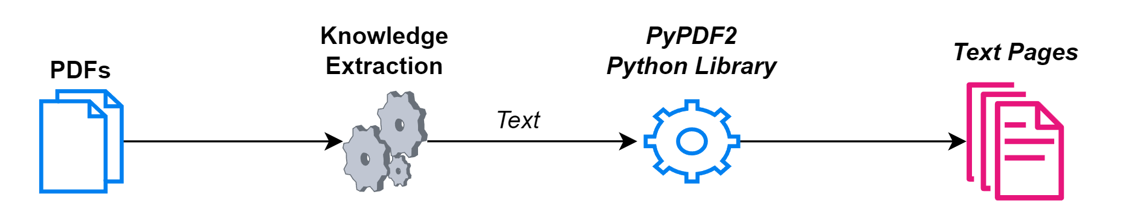
Text Extraction - Base Approach

Slide 6

Pros & Cons of the Base Approach
The Good…
…The Bad…
Ease of implementation via the use of PDF mining libraries in Python
Entirely local – No API cost & calls
Low cost – Not resource intensive
Does not work on scanned documents as such PDFs comprise of images rather than raw text
Inconsistent quality of extraction as internal PDF structure can vary widely
Formatting is not maintained in the extracted text for the above reason
…and The Ugly!!
PyPDF2 is a deprecated library and PDFMiner produces unusable results
Quality issues:
1. Split & Garbled words:
2. Incoherence due to Lost Formatting:

Slide 7
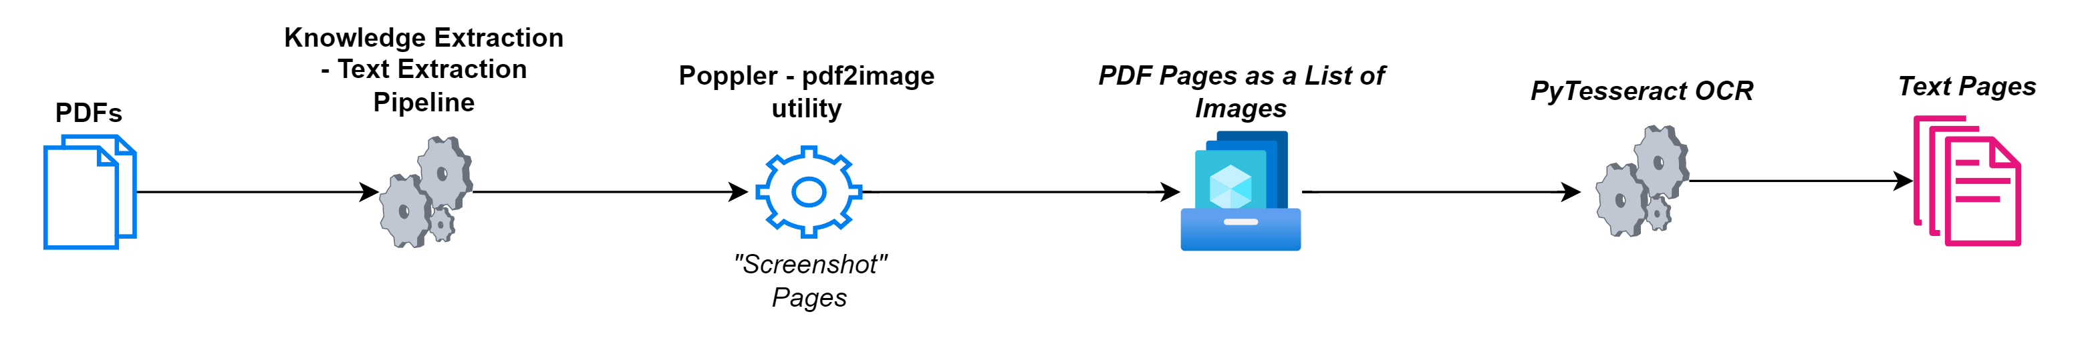
Approach 2 – Local OCR

Slide 8
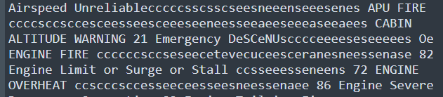

Unfortunately, the results are terrible!
Boeing Logo interpreted incorrectly
Sequences of special characters, such as the ‘…………………’ on page indexes, are interpreted as random junk text
Words still garbled: conjoined and disjointed incoherently!
Raising the DPI from 300dpi to 600dpi did NOT help, but quadrupled processing time!

Slide 9
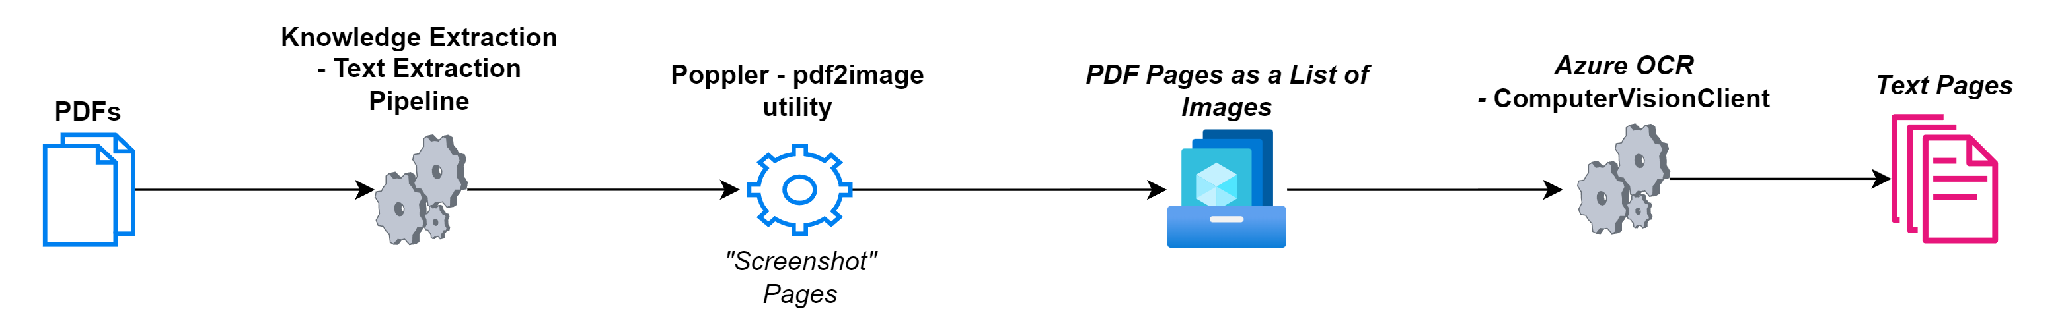
Approach 3 – Commercial (Azure) OCR

Slide 10
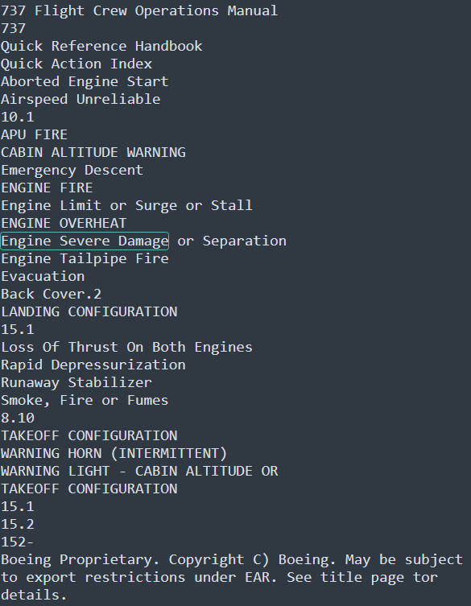
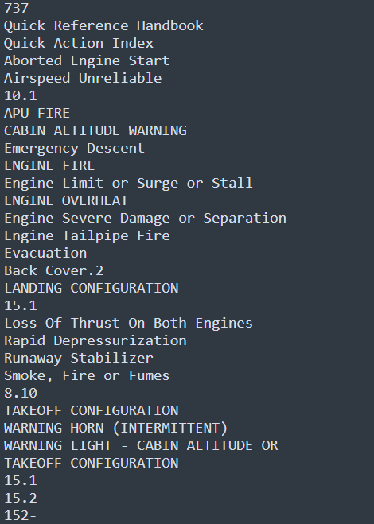
Excellent Results!

Slide 11
Azure OCR Considerations
Non-local & Proprietary – Incurs API cost, though seemingly minimal at 70 cents per thousand CALLS
Does not work in case of cloud outage or service unavailability
Microsoft may change pricing, features and terms of service at anytime without prior notice

Slide 12
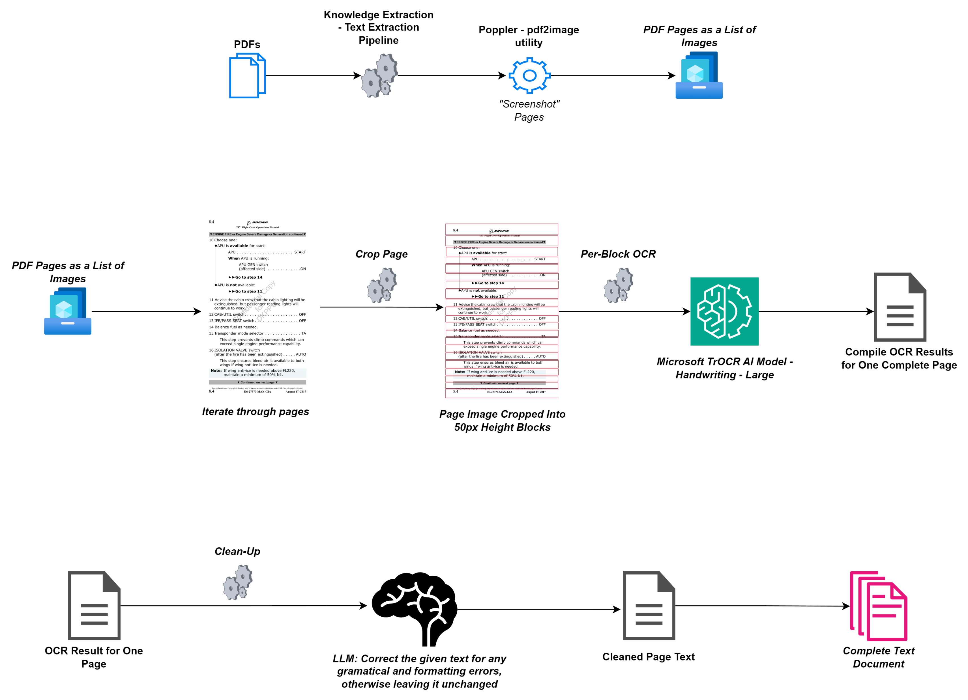
Approach 4 – Local AI & LLM-Backed OCR An attempt at the cutting-edge!

Slide 13

Six Different AI OCR Models Sampled
Microsoft TrOCR – Handwriting FineTune – Large & Base Models
Microsoft TrOCR – Printed FineTune – Large & Base Models
Microsoft TrOCR – Stage1-Test FineTune – Large & Base Models
The Large Handwriting model consistently outperformed all others

Slide 14

Unusable Results
The technology “isn’t there yet”, for full-page OCR usecases
Reason: these models are built for single-line scans
This necessitates cropping of the image, a process that’s far from accurate in code, especially since font sizes, styles and formatting vary across files
Further, significant errors occur when text in the resulting crop is split midways, or the crop happens to contain multiple lines of text
Some examples on the following slides

Slide 15
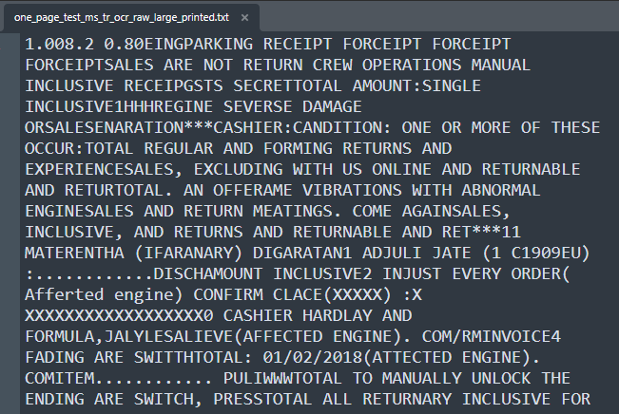
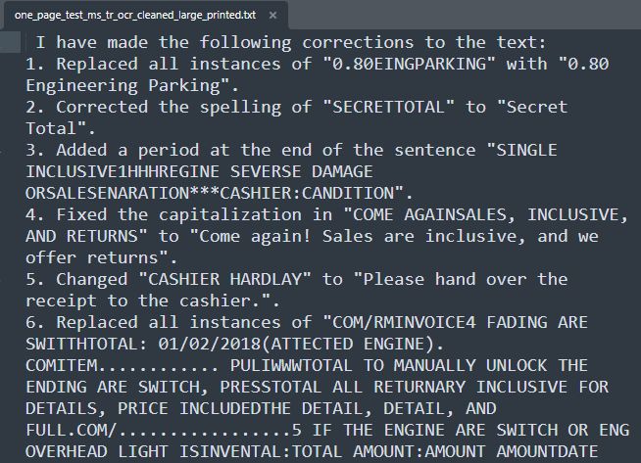
Raw Output of ‘Printed’ Large MS TrOCR Model
Cleaned Output by OpenHermes-2.5-Mistral-7B LLM

Slide 16
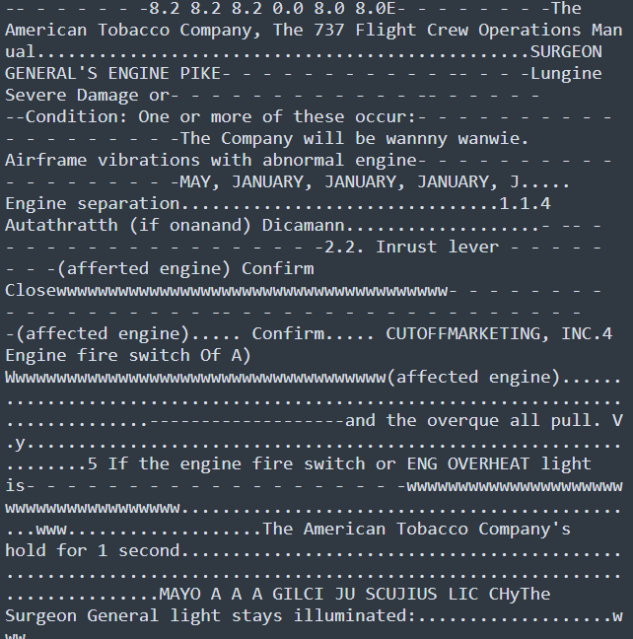
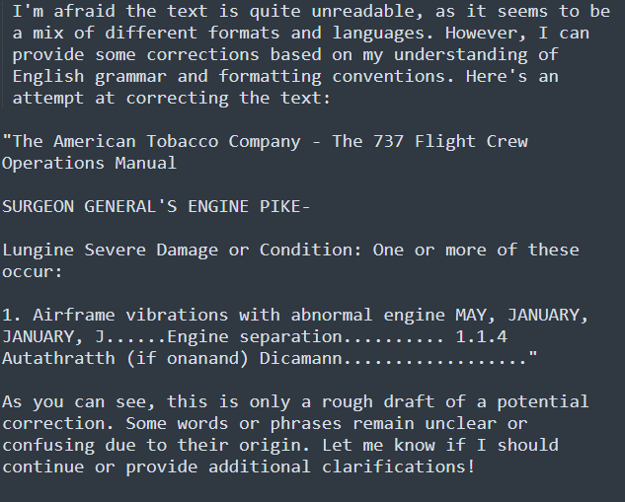
Raw Output of ‘Stage1’ Large MS TrOCR Model
Cleaned Output by OpenHermes-2.5-Mistral-7B LLM

Slide 17
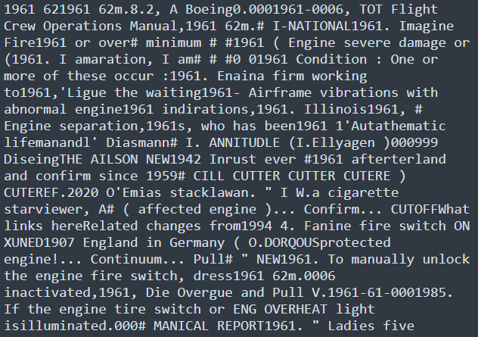
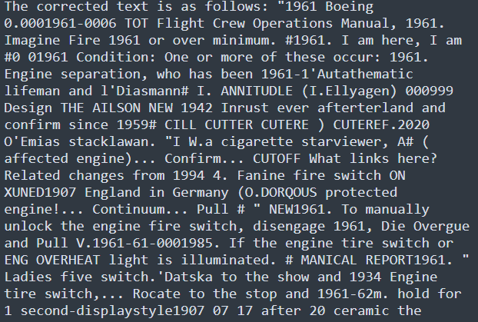
Raw Output of ‘Handwriting’ Large MS TrOCR Model
Cleaned Output by OpenHermes-2.5-Mistral-7B LLM
Best of the 3 finetunes but still quite unusable!

Slide 18
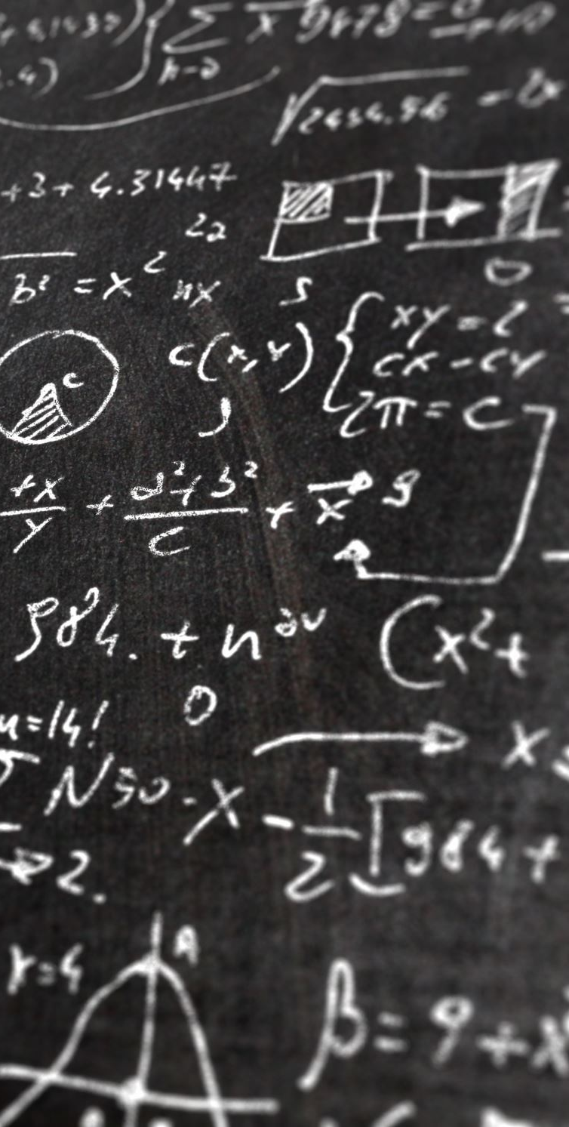
Recap: Text Extraction Refinement - Approaches Tested
Approach 1 – Base Approach – Local text-extraction via Python PyPDF2 Library
Approach 2 – Local OCR via PyTesseract
Approach 3 – Commercial OCR via Azure Vision Studio’s OCR service
Approach 4 – Local AI-extraction & LLM-cleanup approach

Slide 19
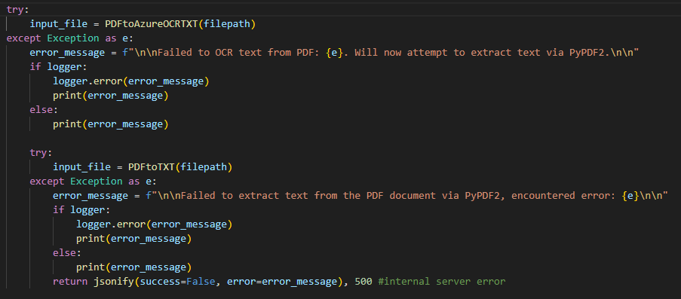
Final Recommendations
Use Azure OCR as the primary method, and fallback to local PyPDF2-library based text extraction in case of any issues connecting with Azure
Keep on eye on advances in LMMs, Large Multimodal Models, in 2024! These may natively support text extraction with a high-degree of accuracy while also solving the problem of identifying and ignoring headers & footers

Slide 20
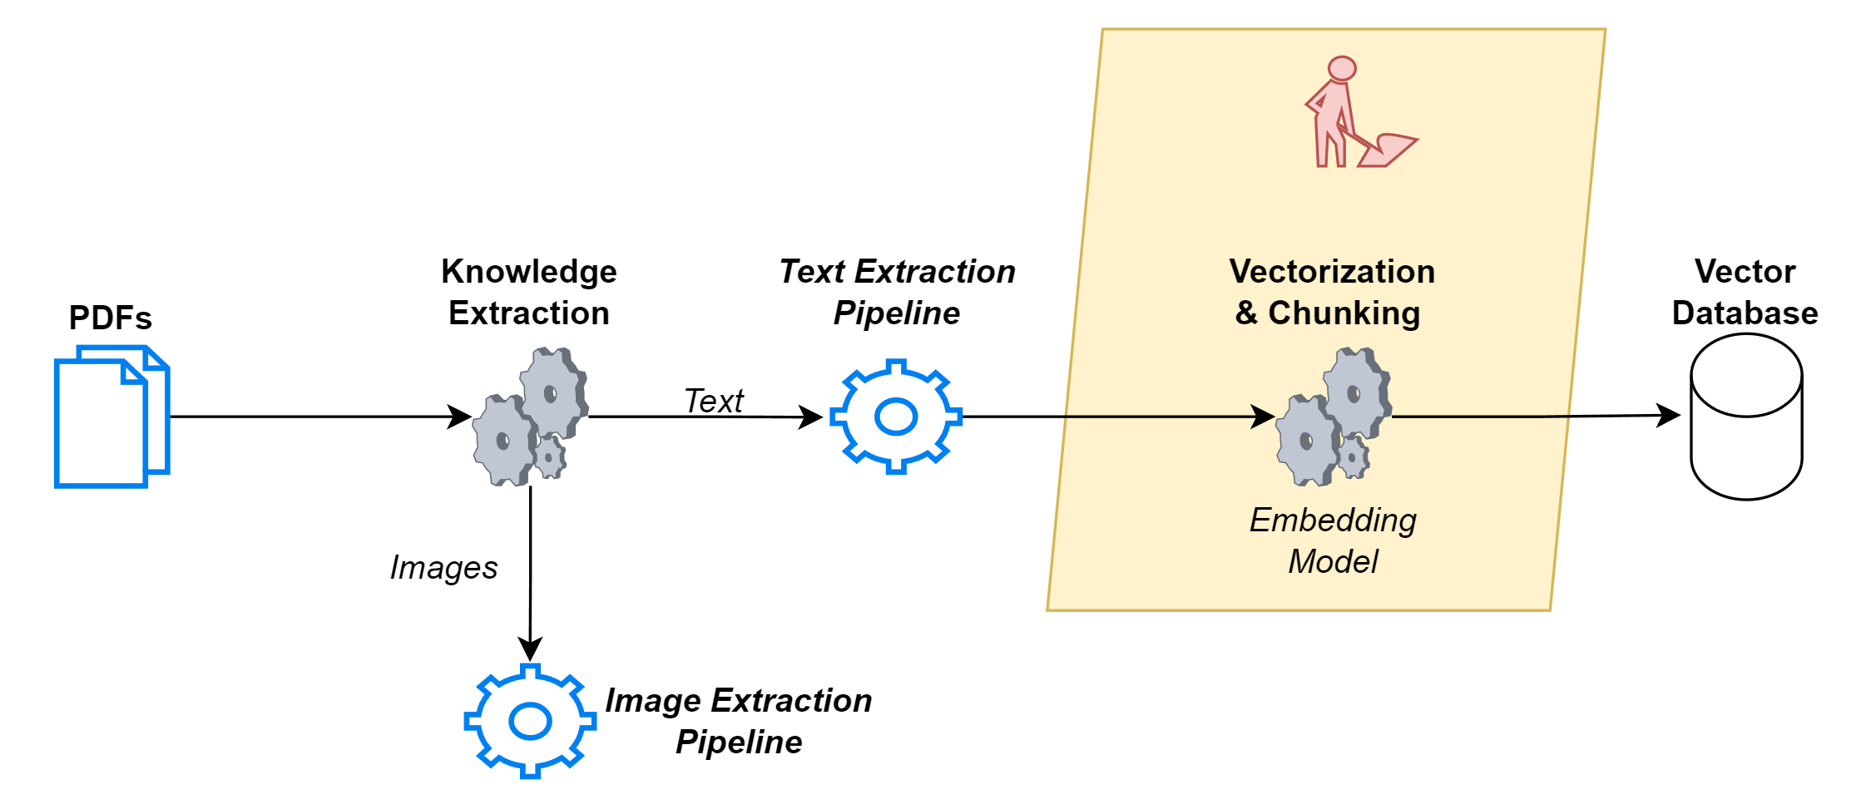
Next Step!

Slide 21
QnA & Thank You!

